Slide 1
Nsw-dpc strategic intelligence-gathering engine
Uts ILAB2
Members:
Justin qi (14337911)
Phoebe Jacinda-santoso (24600088)
Antonio wang (12972042)

Slide 2


AGENDA
Team introduction
Project overview
Data understanding
findings
challenges
Next steps

Slide 3






Team introduction
Microsoft Teams for communication management
Notion for project management
Members
Contribution
Github for development organisation
Justin Qi
Project management
Pipeline Design
Data Engineering
Phoebe Jacinda-Santoso
Statistical modelling
Data analysis
Dashboarding
Microsoft Azure for infrastructure management
Antonio Wang
Data Engineering
Data Analysis
Advanced Modelling
Databricks Azure for
data pipelining
Power BI for dashboarding

Slide 4
Project overview
Objective:
Extract actionable business insights from patent data to foresee Australia and NSW's technological trends and present these insights through a user-friendly dashboard interface.
AUG 14-31 | PROJECT UNDERSTANDING
SEP 01-10 | DATA UNDERSTANDING
SEP 11-30 | ANALYSIS & MODELLING
OCT 01-10 | PROTOTYPING
OCT 11-24 | PRODUCTION
Initiative:
To develop a strategic intelligence-gathering engine that can guide NSW-DPC's strategic decision-making, ensuring they stay ahead in today's fast-paced tech landscape.
Client Needs:
Accurate tech trend predictions.
Competitive benchmarking within the industry.
Identifying potential innovation gaps and opportunities.
Notes:
The current technological landscape is fast-evolving. A strategic approach to intelligence gathering is imperative for future readiness.
Competitive advantage hinges on informed decisions and proactive measure
To develop a strategic intelligence-gathering engine that detects and predicts Australia’s and NSW’s future trajectories of emerging technology. Presented in a user-friendly interface.
Client Needs:
Accurate tech trend predictions.
Competitive benchmarking within the industry.
Identifying potential innovation gaps and opportunities

Slide 5
Data understanding
Overview
Key features used
Source: Lens.org
Entries: 12,944 patent records
Date Range: 2019-2023
Columns: 34 (covering aspects like jurisdiction, description, citations, classifications, etc.)
Format: JSON
Identification & Metadata:
lens_id: Patent ID
date_published: Publish Date
kind: Patent Type
invention_title: Invention Title
Textual Information:
text: Patent Details
claim_text: Patent Claims
Key Players:
applicant_name: The name(s) of the applicant(s)
inventor_name: The name(s) of the inventor(s)
Classification & Description:
main_cpc: Main CPC
sub_cpc: Subsidiary CPC
main_cpc_description: Main CPC Desc.
sub_cpc_description: Sub CPC Desc
Patent Status & Details:
granted: Granted Status
patent_status: Current Status
grant_date: Grant Date
Jurisdiction Details:
jurisdiction: Jurisdiction or region where the patent was applied for

Slide 6

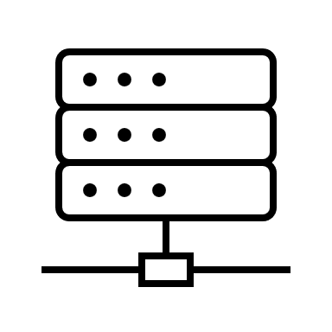







Data Pipeline
ELT Pipeline
Complete Workflow
Extract
Data Extraction
Upload to Azure
Silver Layer
Bronze Layer
Load
Gold Layer
Power BI
Transform

Slide 7
methods & techniques
Topic modelling
Temporal analysis
CPC Symbol analysis
Applicant analysis
Machine learning

Slide 8
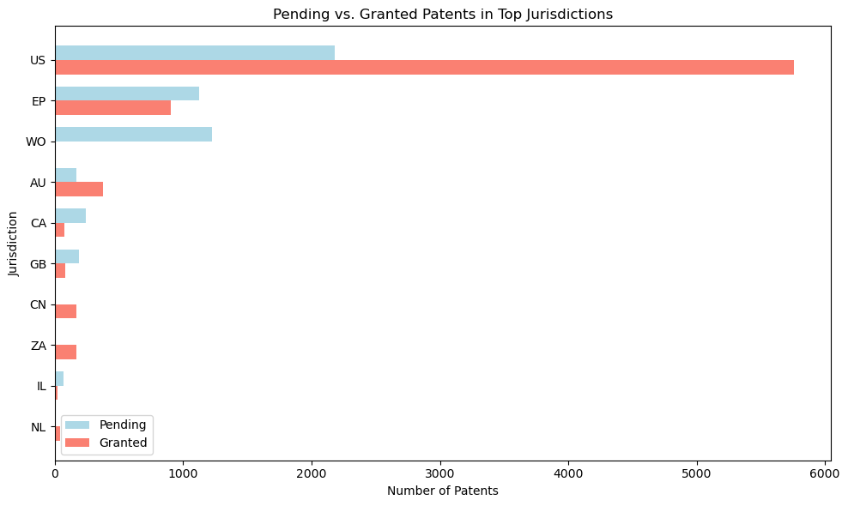
Jurisdiction analysis
Number of patents filed by each jurisdiction
Key findings
China (CN) and United States emerges as the epicentre of innovation
Followed by Europe (EU), International (WO), and Korea (KR)
Global Diversification
Notes:
US Leadership:
The United States (US) emerges as the epicenter of innovation within the studied dataset.
It holds a distinct lead, with the highest number of patents filed, underscoring its dominant position in the global intellectual property landscape.
European and International Presence:
The European Patent Office (EP) and the World Intellectual Property Organization (WO) follow the US in patent filings.
Their significant contributions highlight the importance of Europe and international collaborations in the patent ecosystem.
Global Diversification:
While the US, EP, and WO lead the charge, it's essential to acknowledge contributions from other jurisdictions.
The diverse range of filing jurisdictions emphasizes the global nature of innovation and the interconnectedness of the patent world.

Slide 9
Identifying ‘hot’ sectors
10 distinct topic areas:
Fluid Mechanics & Systems
Consumer Electronics & Services
Electronics & Circuitry
Semiconductor Manufacturing
Material Science & Processes
Automotive Technology
FinTech & Blockchain
Data Management & Networking
Telecommunications
Energy & Device Management
Methodology
Data preprocessing
Keyword extraction
(TF-IDF, N-grams)
Latent Dirichlet Allocation (LDA)
Self-interpretation

Slide 10
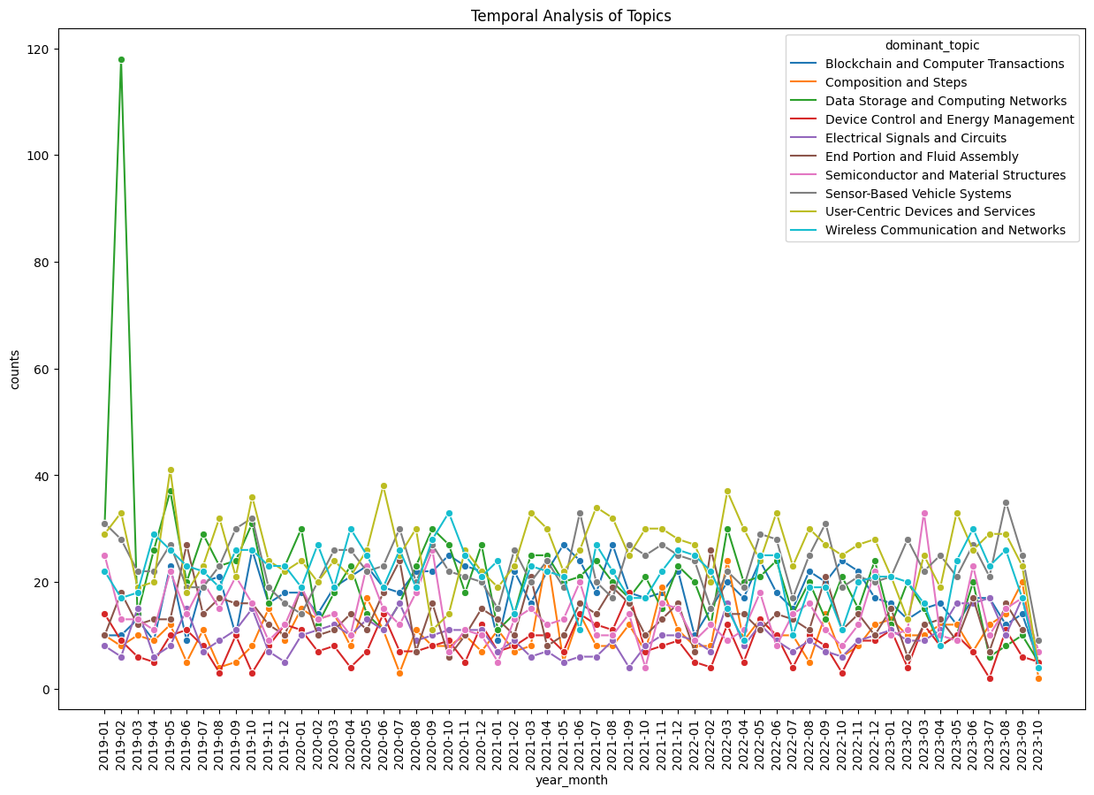
Temporal analysis
Frequency trend of patents filed, grouped by topic
Key findings
A significant spike in "Blockchain and Computer Transactions" around 2019-02.
Steady interest in "Wireless Communication and Networks" since 2019.
Multiple topics show periodic peaks, indicating cyclical trends.

Slide 11
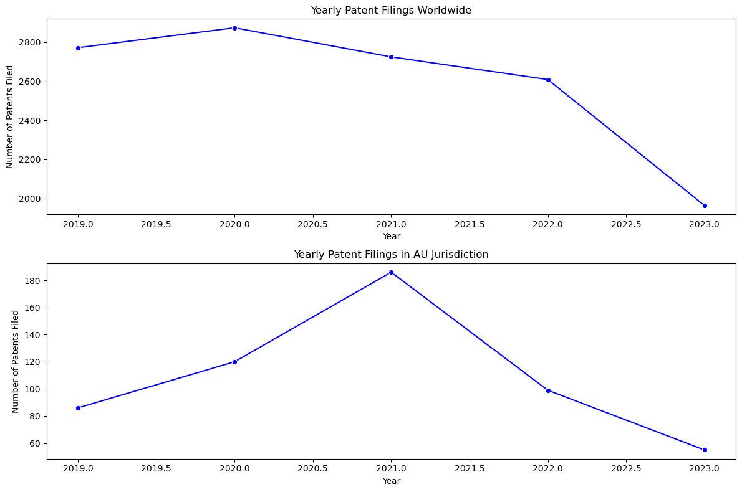
Temporal analysis
Yearly Patent Filings: AU vs Worldwide
Key findings
Steady decline in global filings.
AU filings peaked in 2021.
AU trends oppose global patterns.

Slide 12
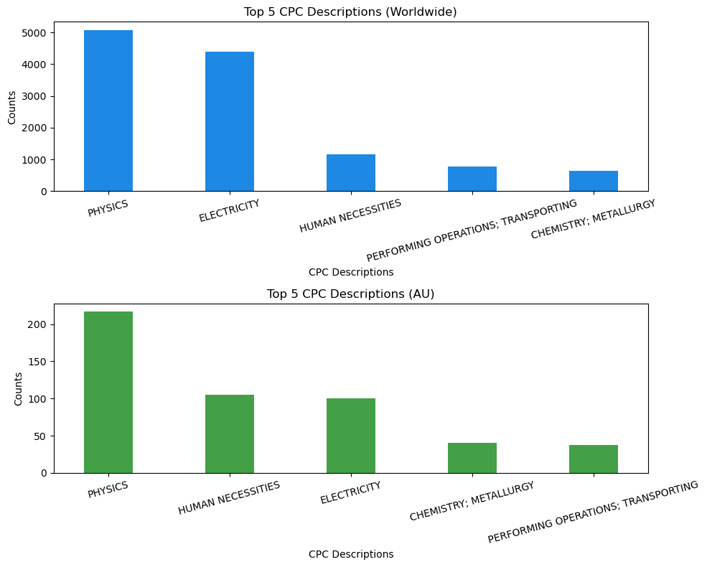
CpC symbol analysis
Top 10 CPC sectors found in patents
Key findings
Dominance of Physics and Electricity in both Worldwide and AU.
Regional Variation: 'HUMAN NECESSITIES' is more significant in AU than on the global stage.
Broad Technological Interests: Both datasets showcase diversity in CPC descriptiony.

Slide 13
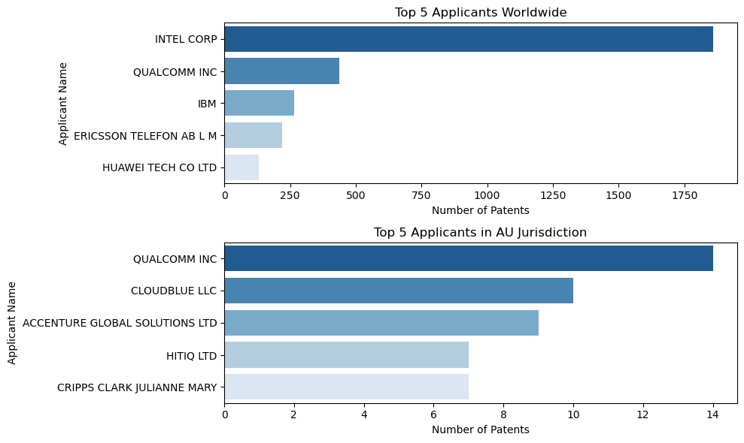
application analysis
Applicants with the greatest number of patents filed
Key findings
Intel leads global patent applications.
Qualcomm prevalent in both global and AU lists.
Diverse applicants in AU, including individuals.

Slide 14

Machine learning
Text Summarization
Sentiment Analysis & Categorization
Topic Modelling
Model: Longformer2Roberta
Tool: Huggingface Transformers
Models: Sentiment-analysis pipeline, Custom aggregation and mapping
Tool: Huggingface Transformers
Model: Latent Dirichlet Allocation (LDA)
Outcome: Dominant topic per document
Text Classification
Text Summarization (T5 Model)
Time Series Forecasting
Model: Sentiment-analysis pipeline
Derived metrics: Time Horizon, Opportunity-Challenge, Likelihood, Degree of Change, Scale of Impact
Model: T5-small
Tool: Huggingface Transformers
Model: ARIMA
Outcome: Trajectory of future trends in patent publications

Slide 15


Challenges faced
Data challenges
Incomplete Data
High Dimensionality
Diverse Data Sources
Solution: Advanced imputation techniques & domain-specific knowledge
Solution: Applied dimensionality reduction techniques
Solution: Unified data preprocessing pipeline to standardize entries.
technical challenges
Scalability Issues
Model Overfitting
Integration with Power BI
Solution: Employed distributed computing resources.
Solution: Regularization techniques and cross-validation to ensure model robustness
Solution: Drawing inspiration from Trend Atlas
business challenges
Aligning with Client Needs
Time Constraints
Solution: Regular consultations and feedback loops.
Solution: Prioritizing key deliverables and iterative development
Notes:
1. Data Challenges
Incomplete Data: Many patent records lacked critical information or had missing values. Solution: Utilized advanced imputation techniques and domain-specific knowledge to fill gaps.
High Dimensionality: The dataset had numerous columns, making analysis computationally expensive. Solution: Applied dimensionality reduction techniques like PCA to retain vital information while reducing complexity.
Diverse Data Sources: Patent records came from various jurisdictions with differing formats. Solution: Designed a unified data preprocessing pipeline to standardize entries.
2. Technical Challenges
Scalability Issues: The sheer volume of data made some algorithms run slower. Solution: Optimized algorithms and employed distributed computing resources.
Model Overfitting: Initial models were too sensitive to training data nuances. Solution: Incorporated regularization techniques and cross-validation to ensure model robustness.
Integration with User Interface: Ensuring seamless integration of the engine with the user-friendly interface. Solution: Collaborated closely with front-end developers and utilized API-driven approaches for smooth integration.
3. Business Challenges
Aligning with Client Needs: Understanding and translating business requirements into actionable data insights. Solution: Regular consultations and feedback loops with stakeholders to ensure alignment.
Time Constraints: The project had tight deadlines which added pressure. Solution: Adopted agile methodologies, prioritizing key deliverables and iterative development.

Slide 16







next steps
Infrastructure Enhancement
Continuous Data Ingestion Pipeline Improvements
Cloud Scalability
Data Source Expansion
Incorporate Additional Patent Databases
Integration of Non-Patent Literature
Analytical Capabilities
Advanced ML Models
Trend Prediction Enhancements
User Interface & Experience
Customizable Dashboards
Interactive Data Visualizations
Notes:
1. Continuous Data Integration
Description: Seamless incorporation of new patent data as it becomes available.
Benefits: Ensure the intelligence engine remains updated and relevant.
2. Expansion to Other Data Sources
Description: Beyond Lens.org, integrate with other global patent databases.
Benefits: Broader coverage and more comprehensive insights.
3. Enhanced Natural Language Processing
Description: Implementing cutting-edge NLP techniques to better understand patent abstracts and descriptions.
Benefits: Deeper insights and better trend predictions.
4. User Experience Enhancements
Description: Continuous UI/UX improvements based on user feedback.
Benefits: More intuitive, user-friendly interface for clients.
5. Automated Anomaly Detection
Description: Use AI to automatically identify and flag patents that deviate from trends or show signs of significant innovation.
Benefits: Quick identification of potential game-changers in the technology sector.
6. Collaboration Features
Description: Allow multiple users to collaborate, comment, and share insights on the platform.
Benefits: Facilitates teamwork and collective analysis.
7. Market Integration
Description: Combine patent data with market trends, enabling users to identify potential business opportunities.
Benefits: Linking technological insights to market potentials.

Slide 17
conclusion
Accomplishments
Derived actionable insights from 12,944 patent records.
Built a strategic intelligence-gathering engine, predicting technological trends.
Provided scalable solution for client’s future implementations.
Importance
Pioneered new business understanding of tech evolution.
Positioned the firm as an industry analytics leader.
Appreciation
A sincere thank you to the partners from NSW-DPC for providing continuous valuable feedback, as well as Chris for providing mentorship throughout the journey.

Slide 18
THANK YOU

